Slide 1
Azure Cosmos DB(Data Migration)[
In this we are going to create Azure Cosmos Db and in that we will create Mongo DB. Then we will migrate data from Mongo DB to ADF to Azure SQL Server. It works on NoSQL.
(Storage + Processing)(NoSQL)
Azure Cosmos Db > ADF > Azure SQL Database

Slide 2
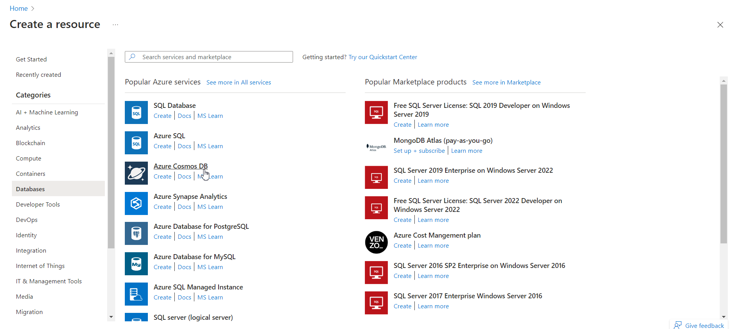
Go to Databases > Azure Cosmos DB

Slide 3
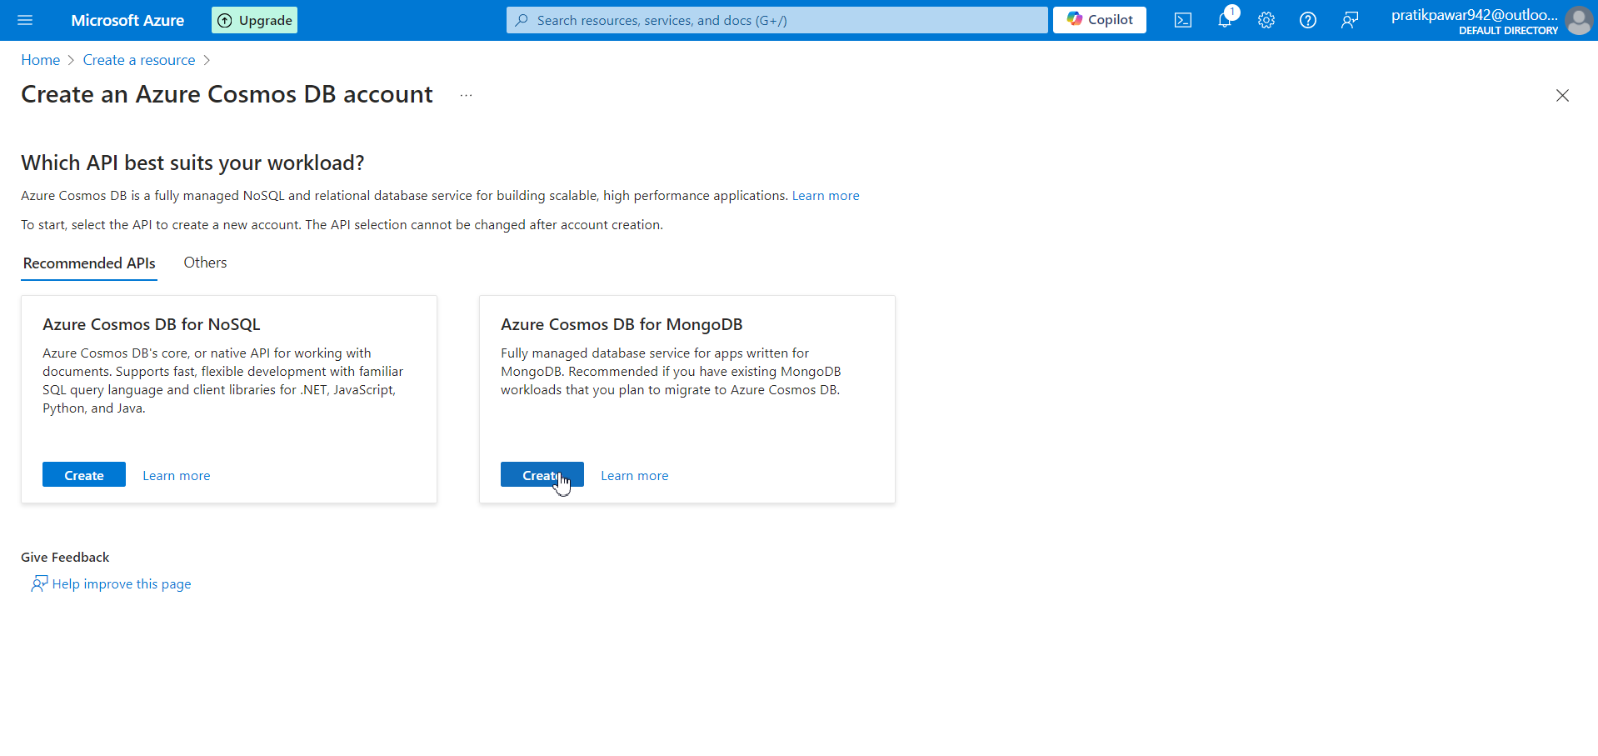
Select Azure Cosmos DB for MongoDb

Slide 4
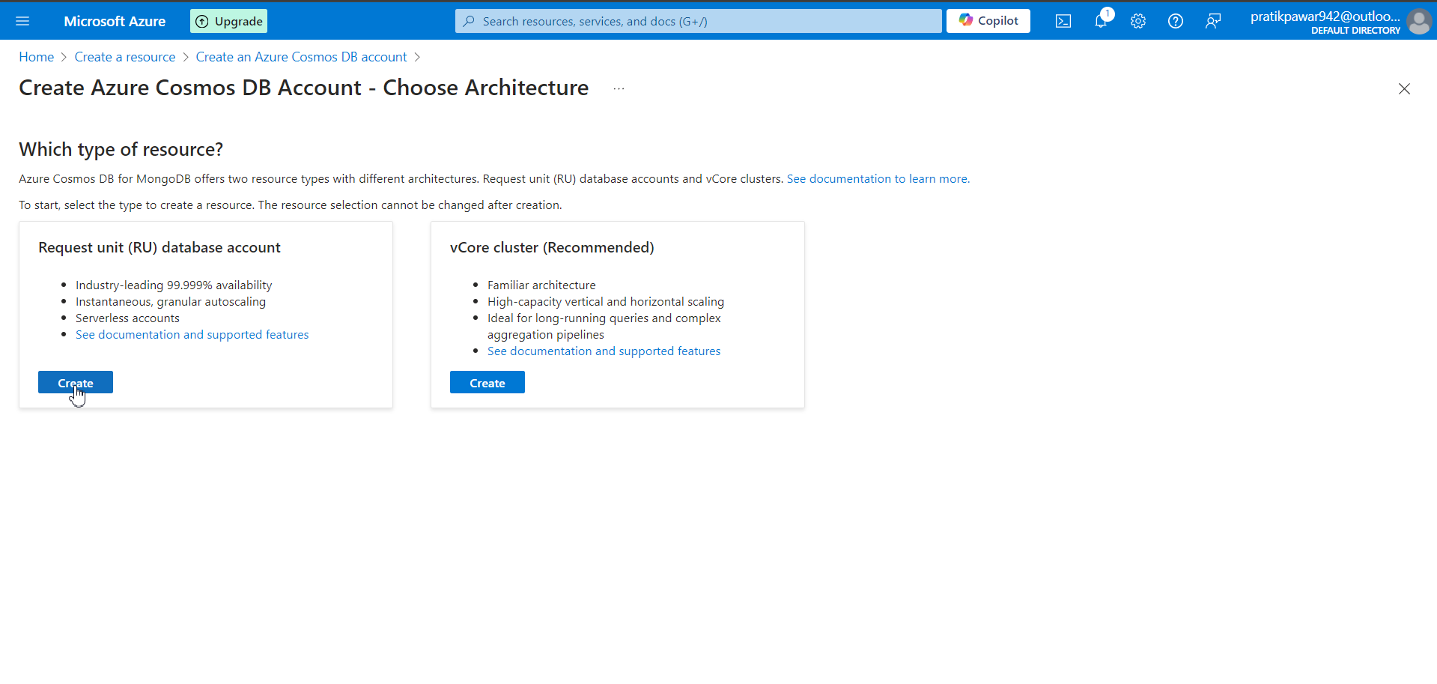
Resource :Choose according to Requirement ( Here we use Request Unit for practice)

Slide 5
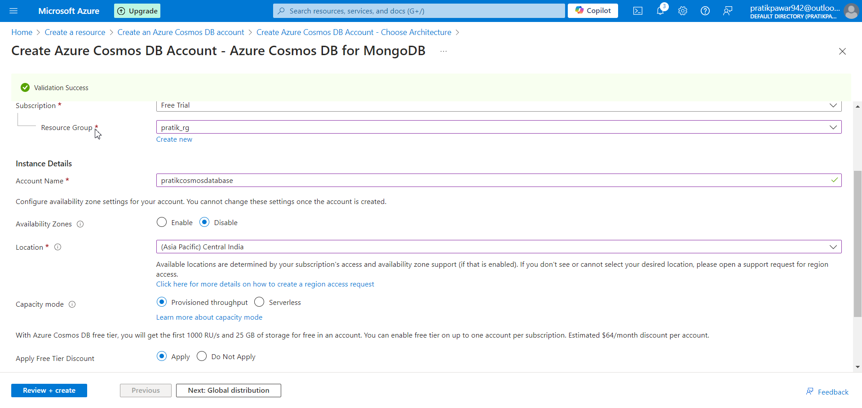
Fill the Details

Slide 6
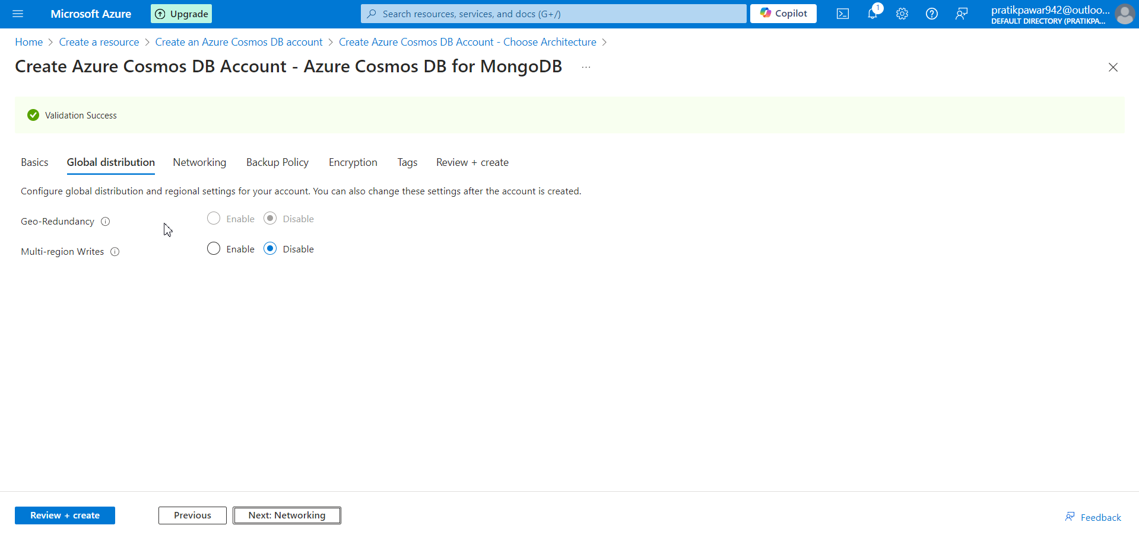
Networking

Slide 7
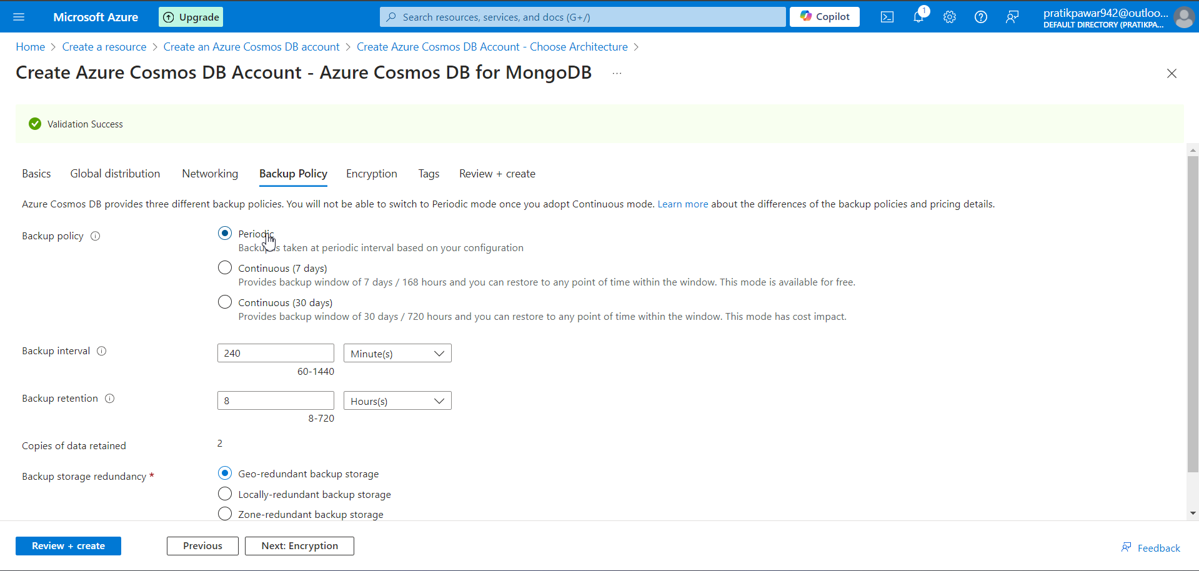
Backup Policy

Slide 8
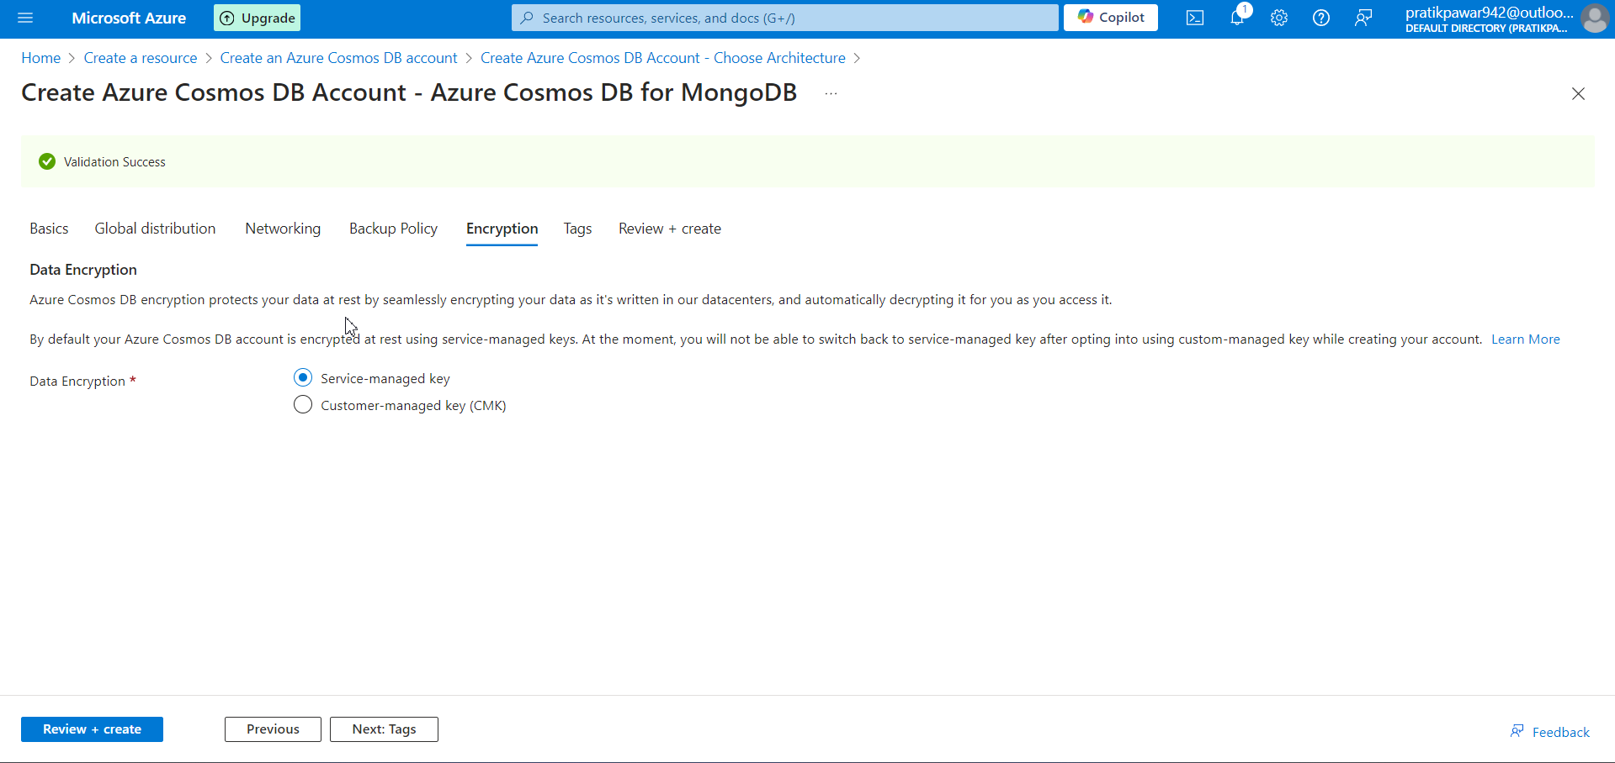
Encryption

Slide 9
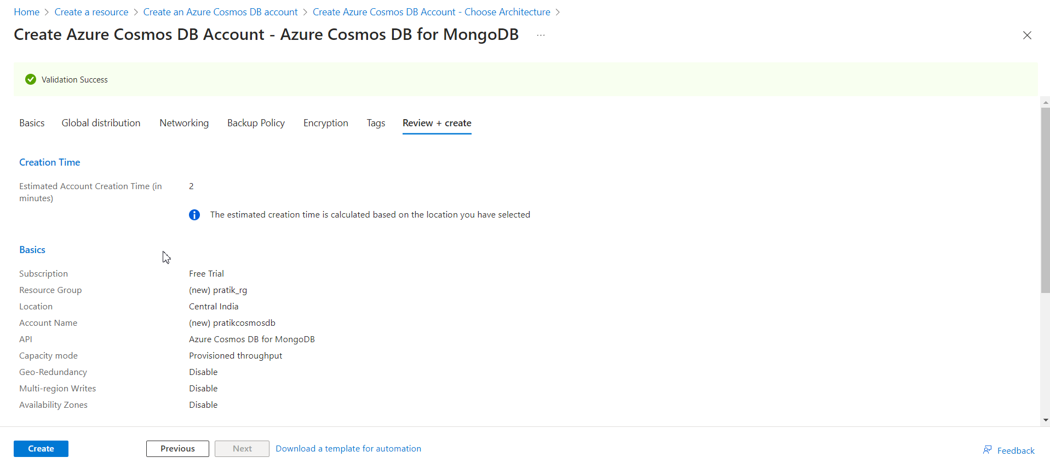
Create

Slide 10
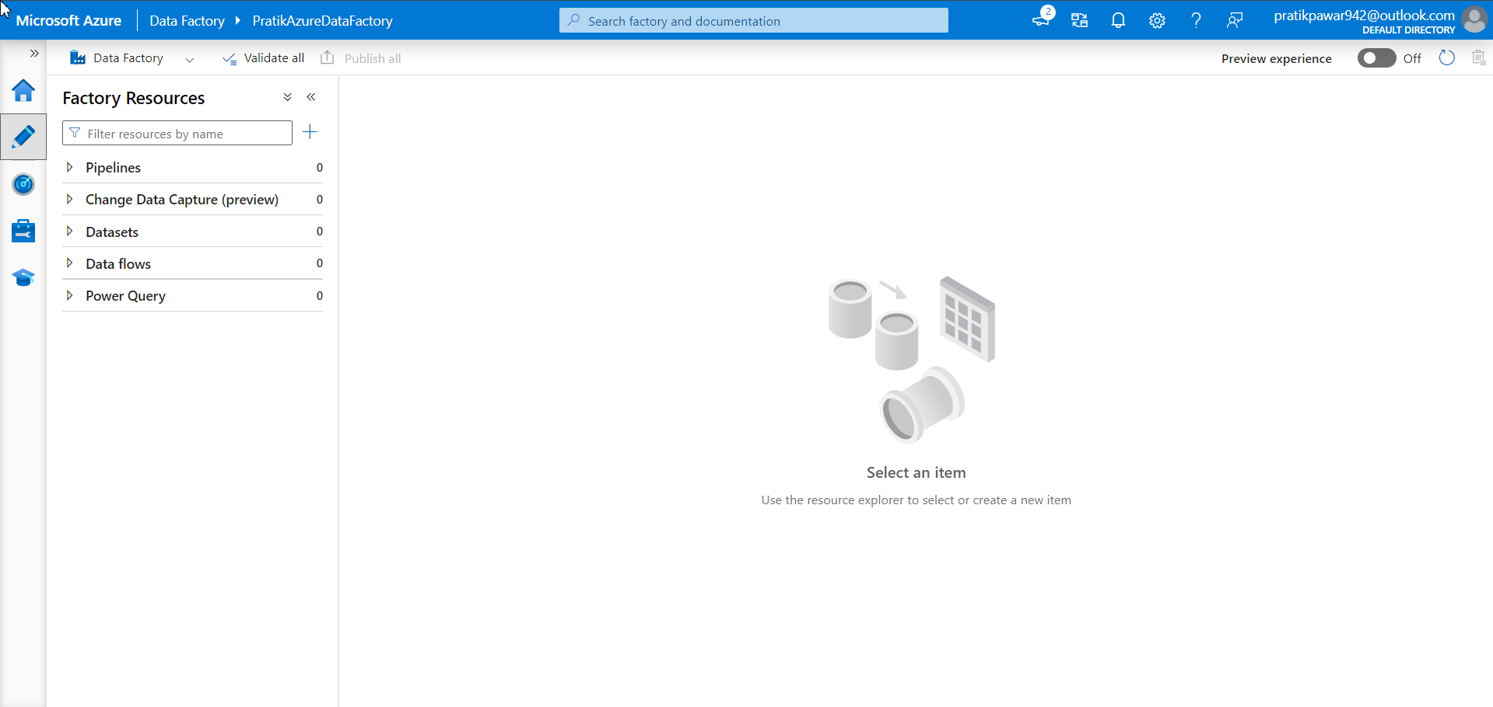
Also create Azure SQL Database and ADF

Slide 11
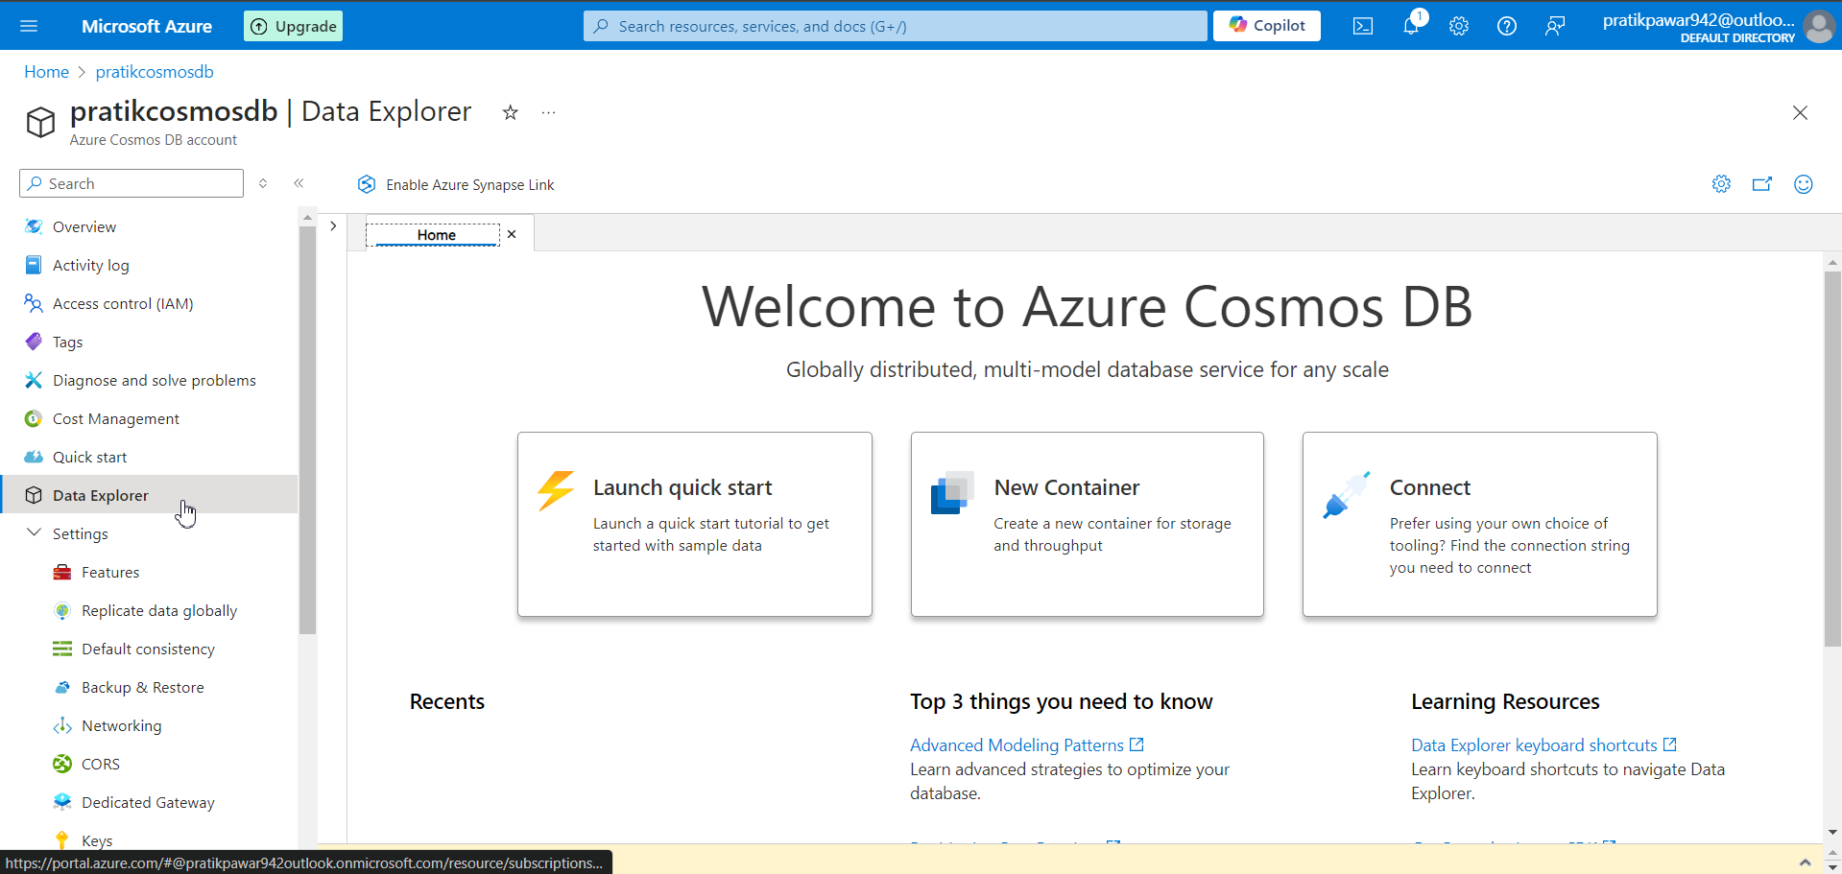
Now go to MongoDB > Data Explorer

Slide 12
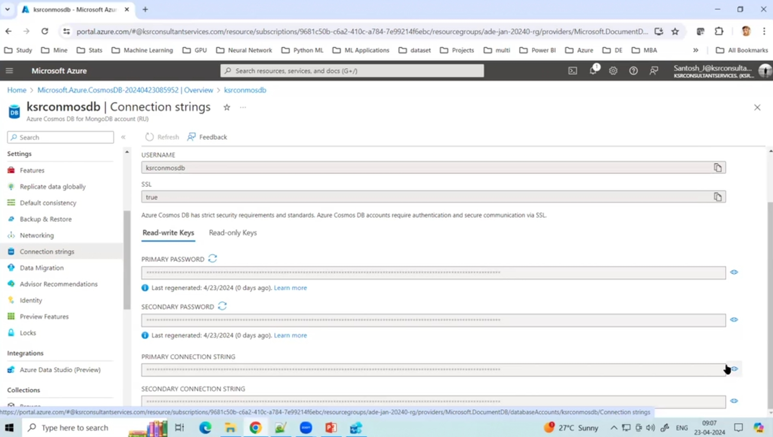
Now Connect to ADS(Azure Data Studio) using Connecting String

Slide 13
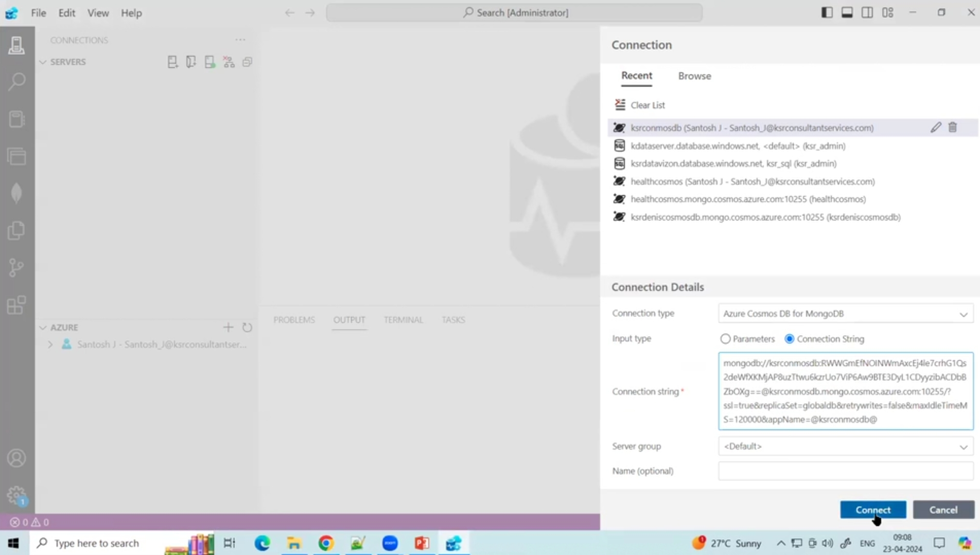
Paste primary connecting string in Connection string

Slide 14
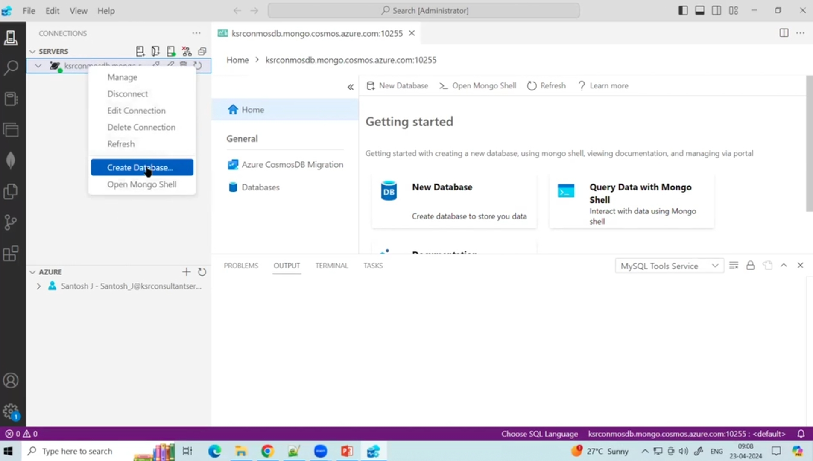
Now server > Create Database

Slide 15
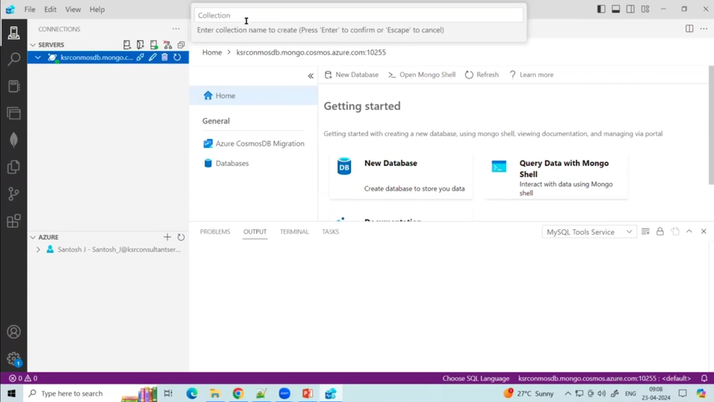
After Hitting Enter it will ask to put Collection name. Type it

Slide 16
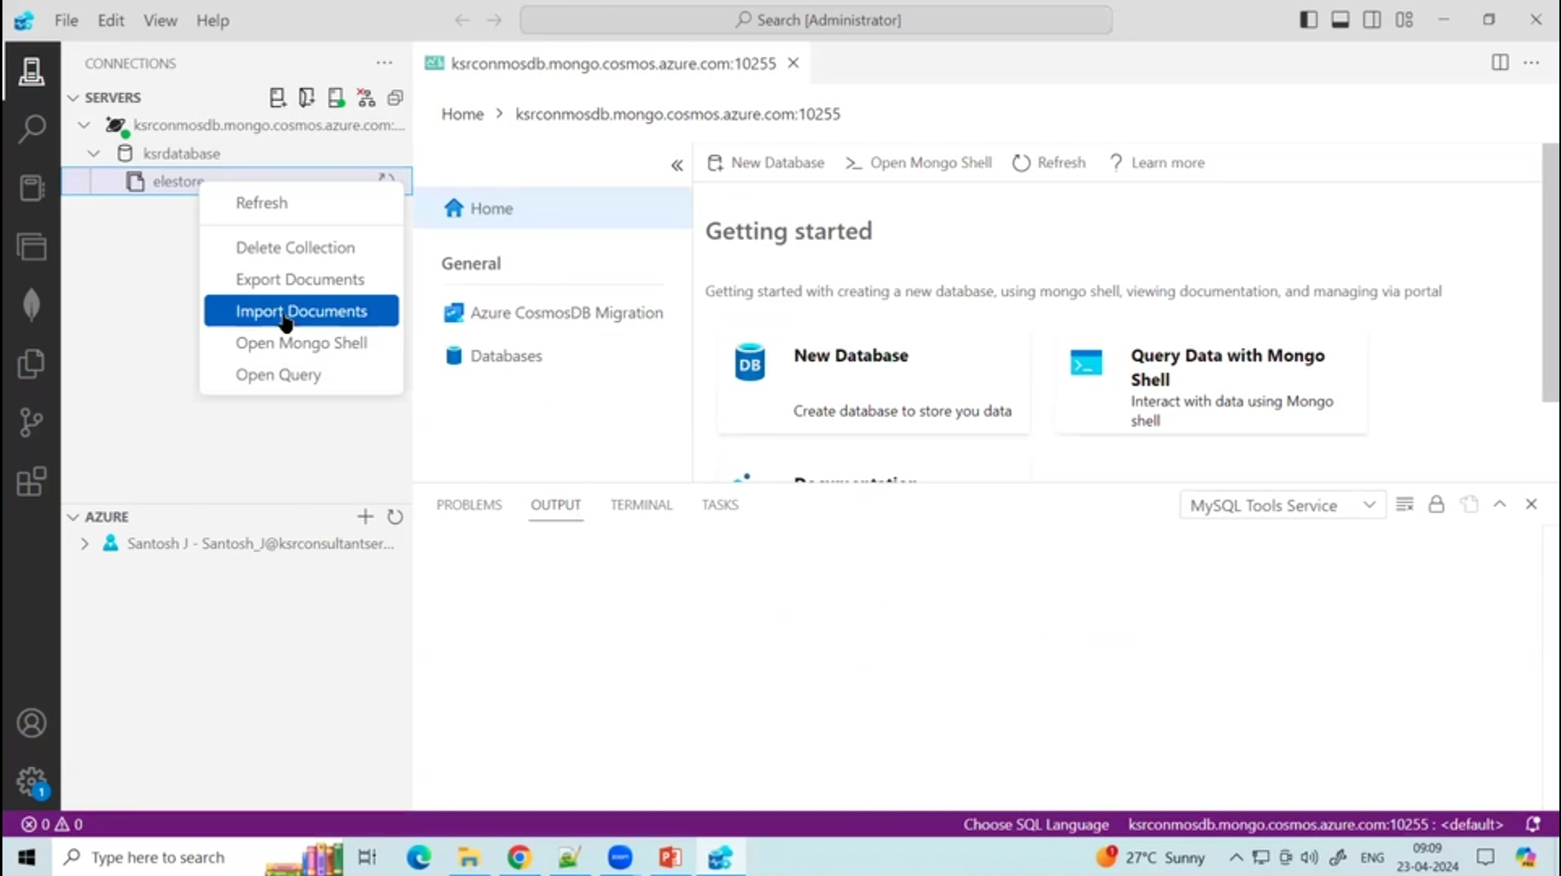
Right click on collection > import Documents

Slide 17
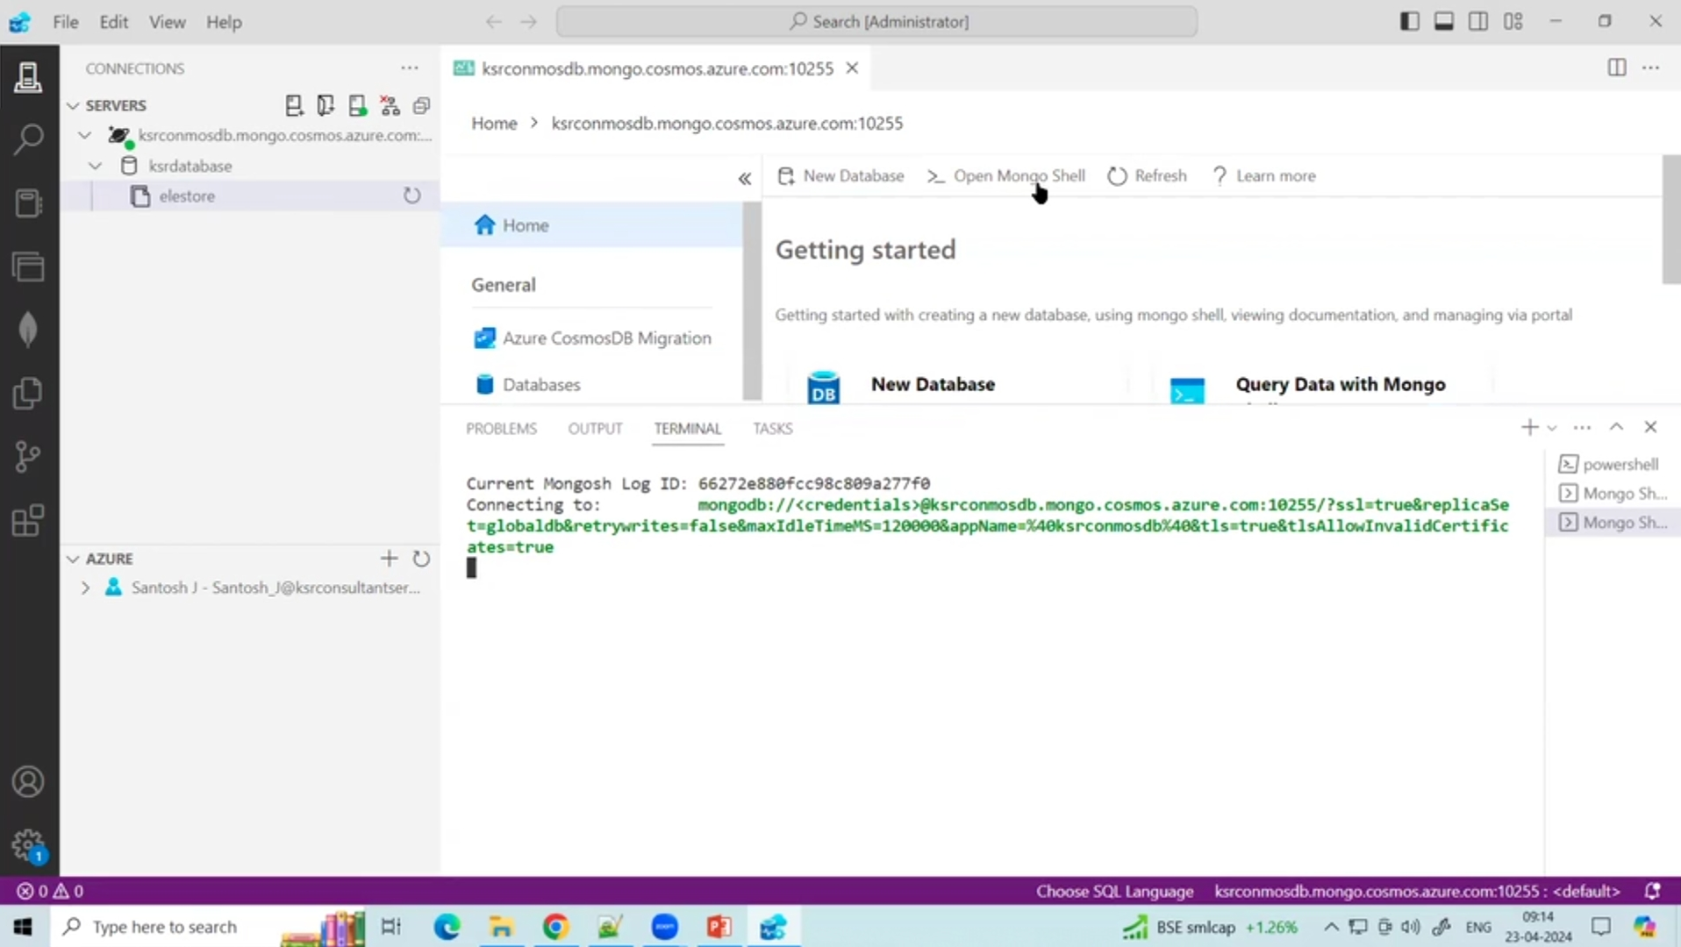
After Importing go to Terminal and Click Mongo Shell to start Code in MongoDB If required

Slide 18
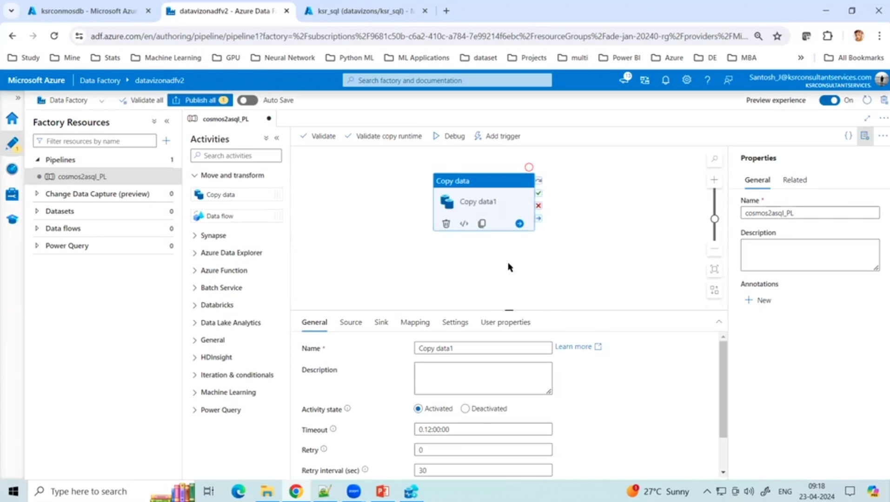
Now go to ADF > New Pipeline > Copy Data Activity

Slide 19
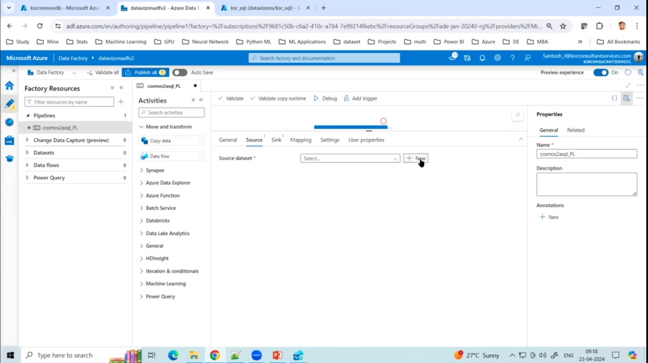
Add Source and Sink

Slide 20
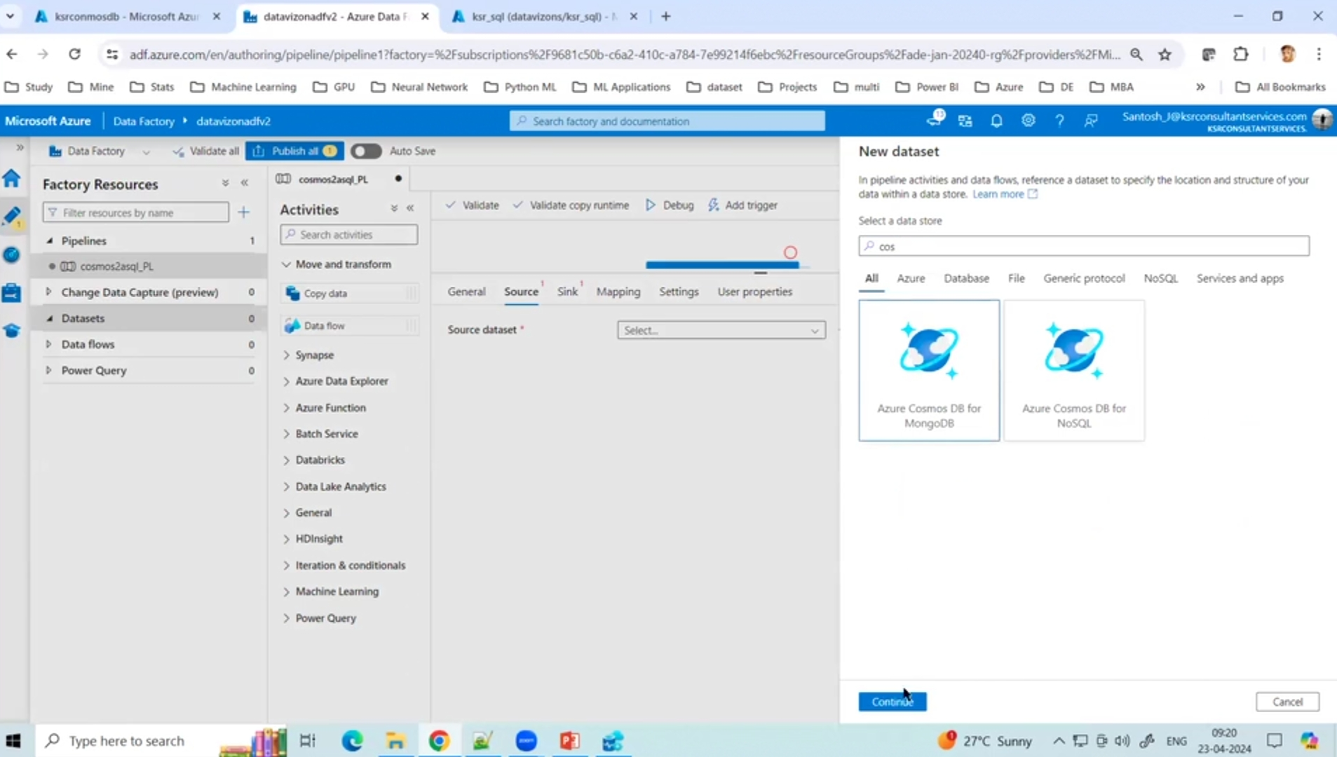
Select Azure Cosmos Db for MongoDB

Slide 21
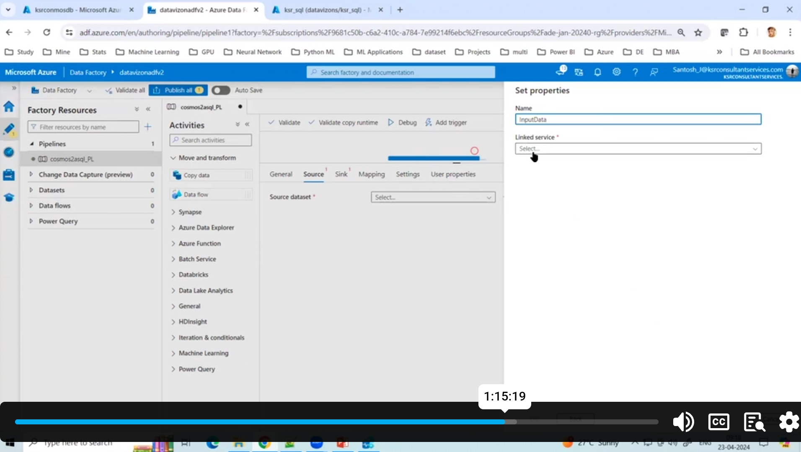
Give name ‘InputData’

Slide 22
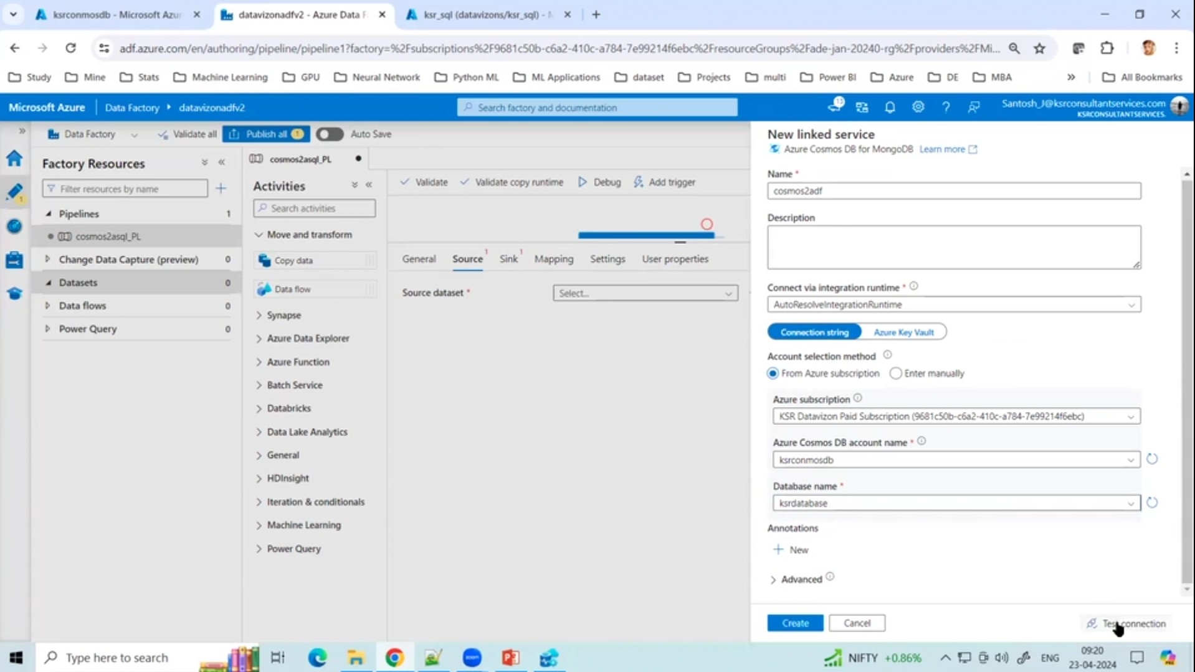
Fill the Required info and test Connection > Create

Slide 23
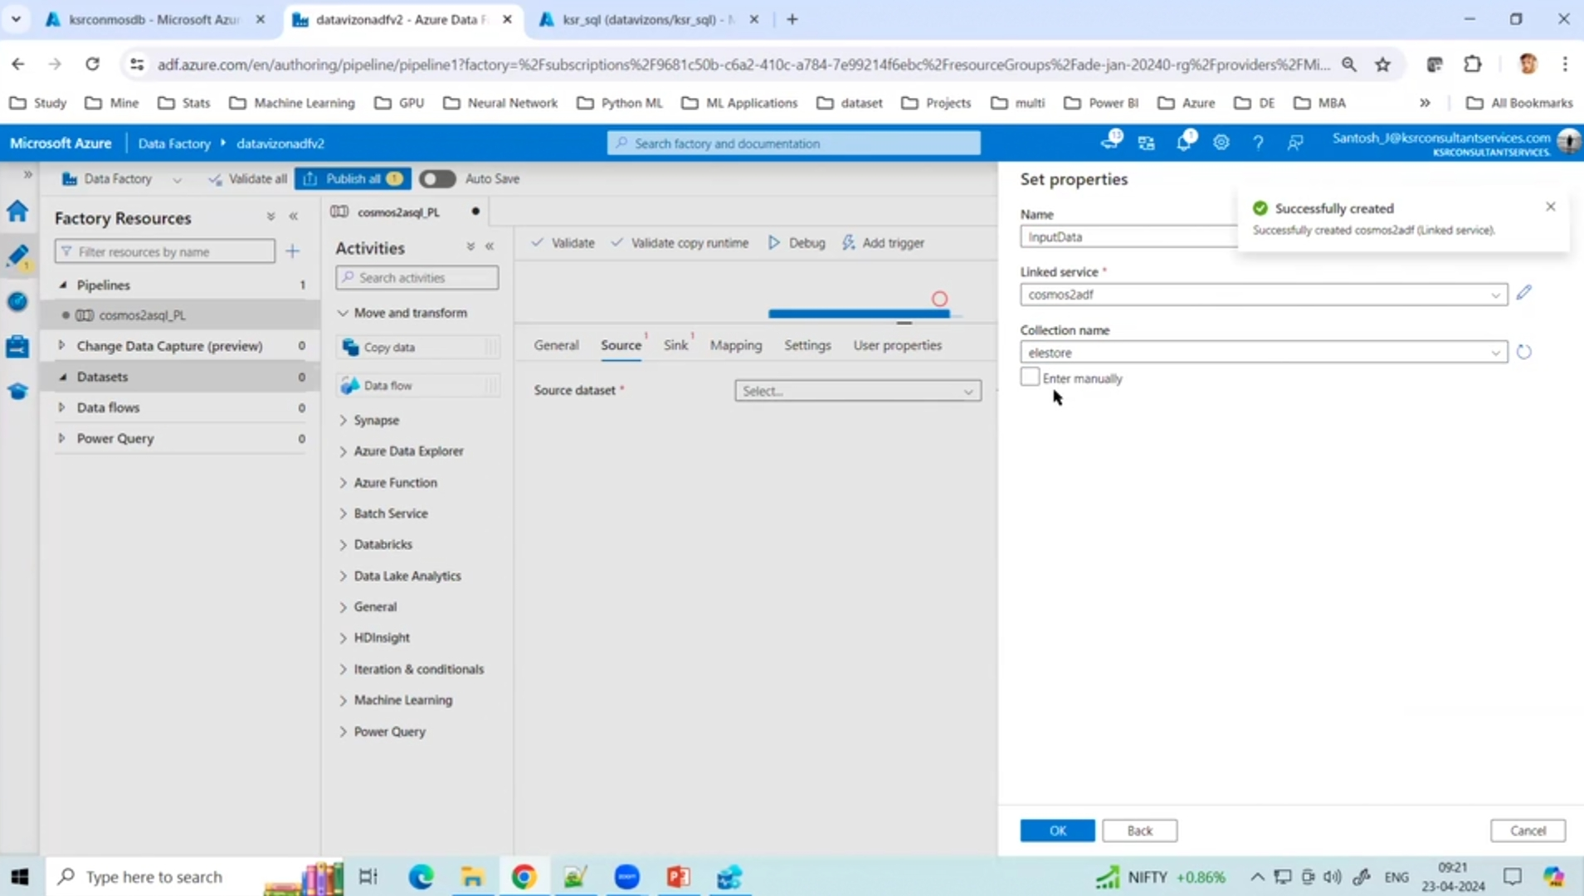
Now Select Collection Name ie ‘elestore’

Slide 24
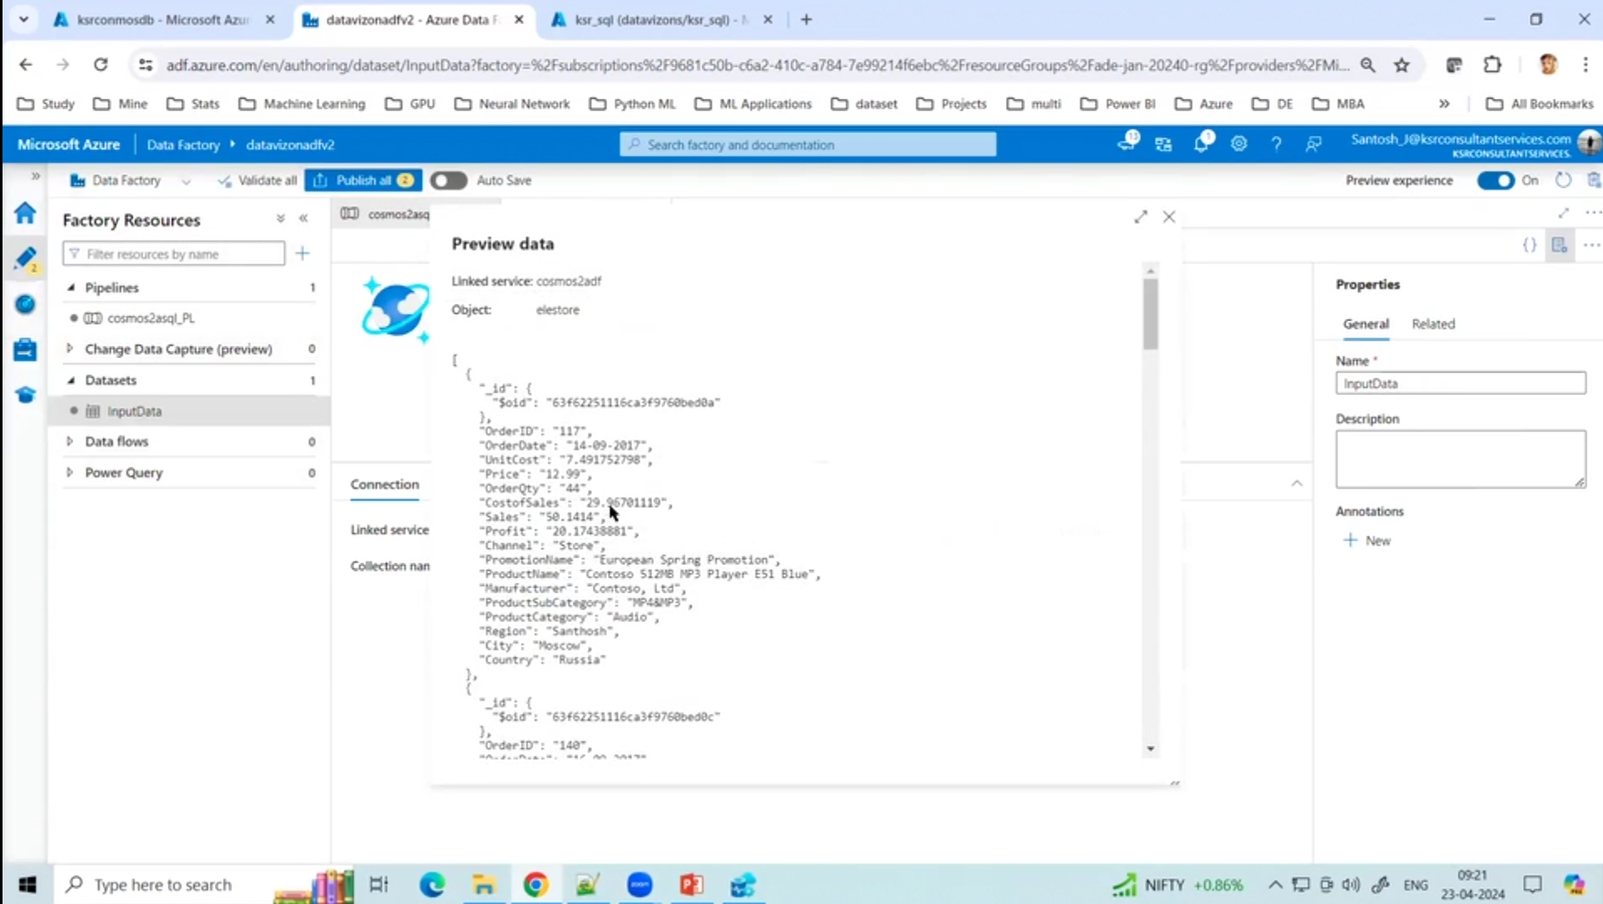
Click on preview data to see data is correct or not

Slide 25
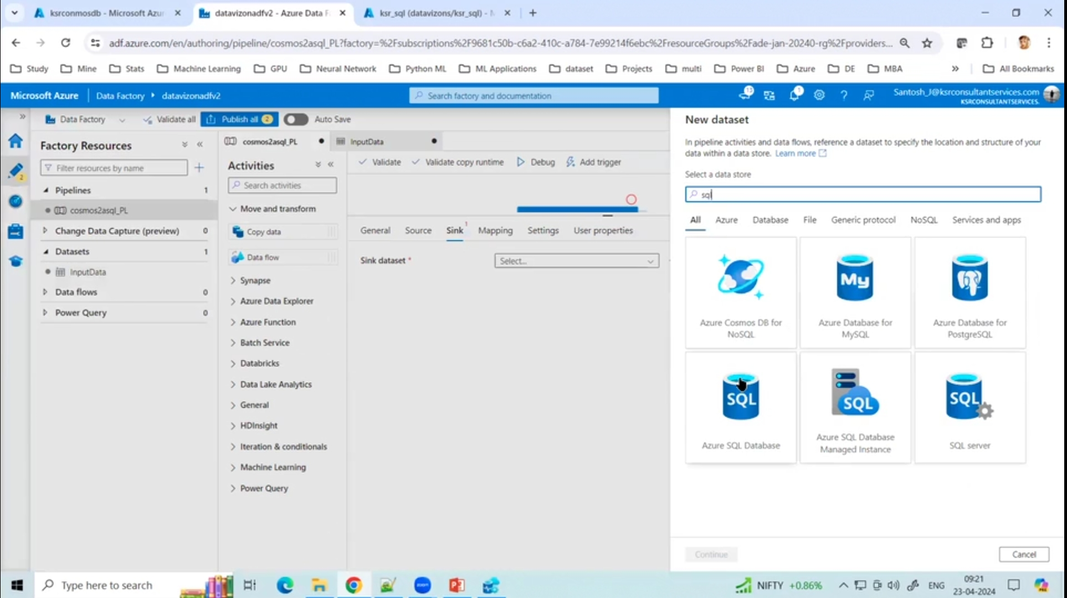
Now add Sink > Azure SQL Database

Slide 26
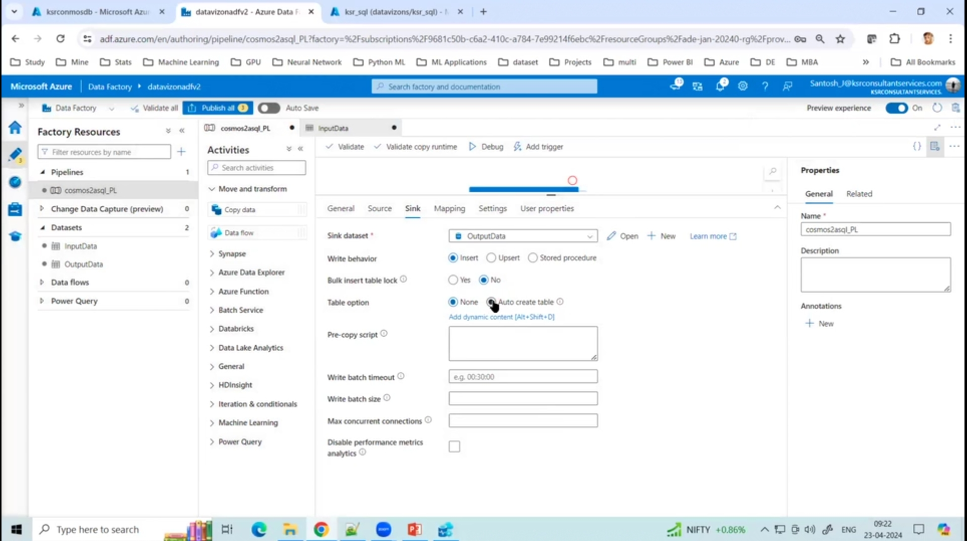
After Creating sink, go to Table option > auto create table

Slide 27
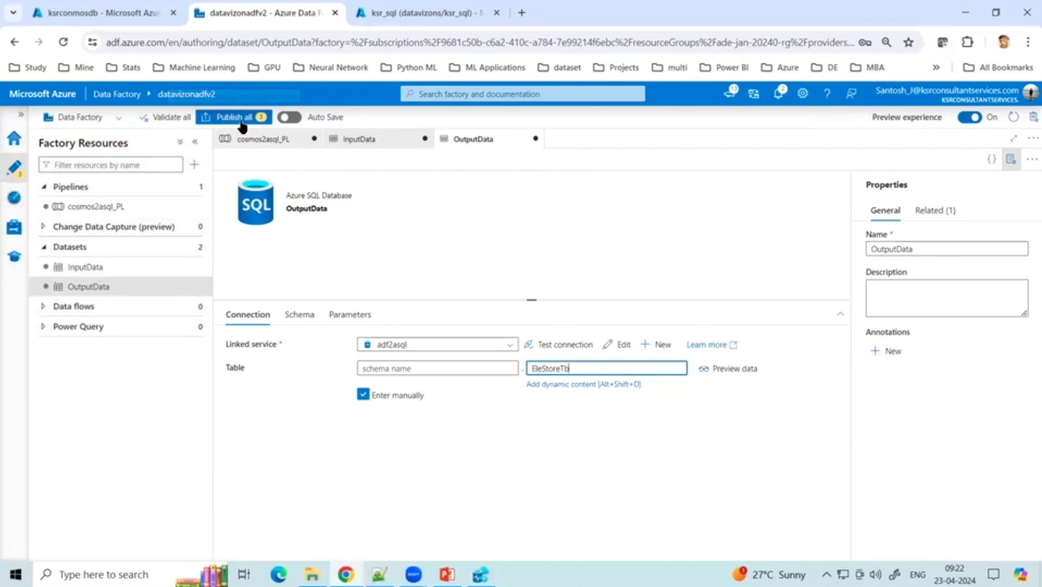
Now go to datasets > output data > select enter manually > write the output table name > Publish

Slide 28
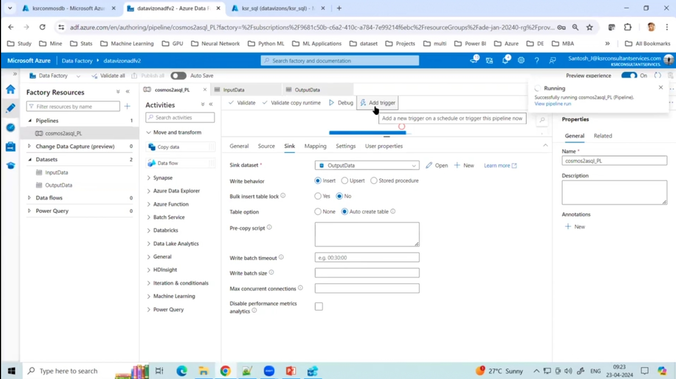
Trigger

Slide 29
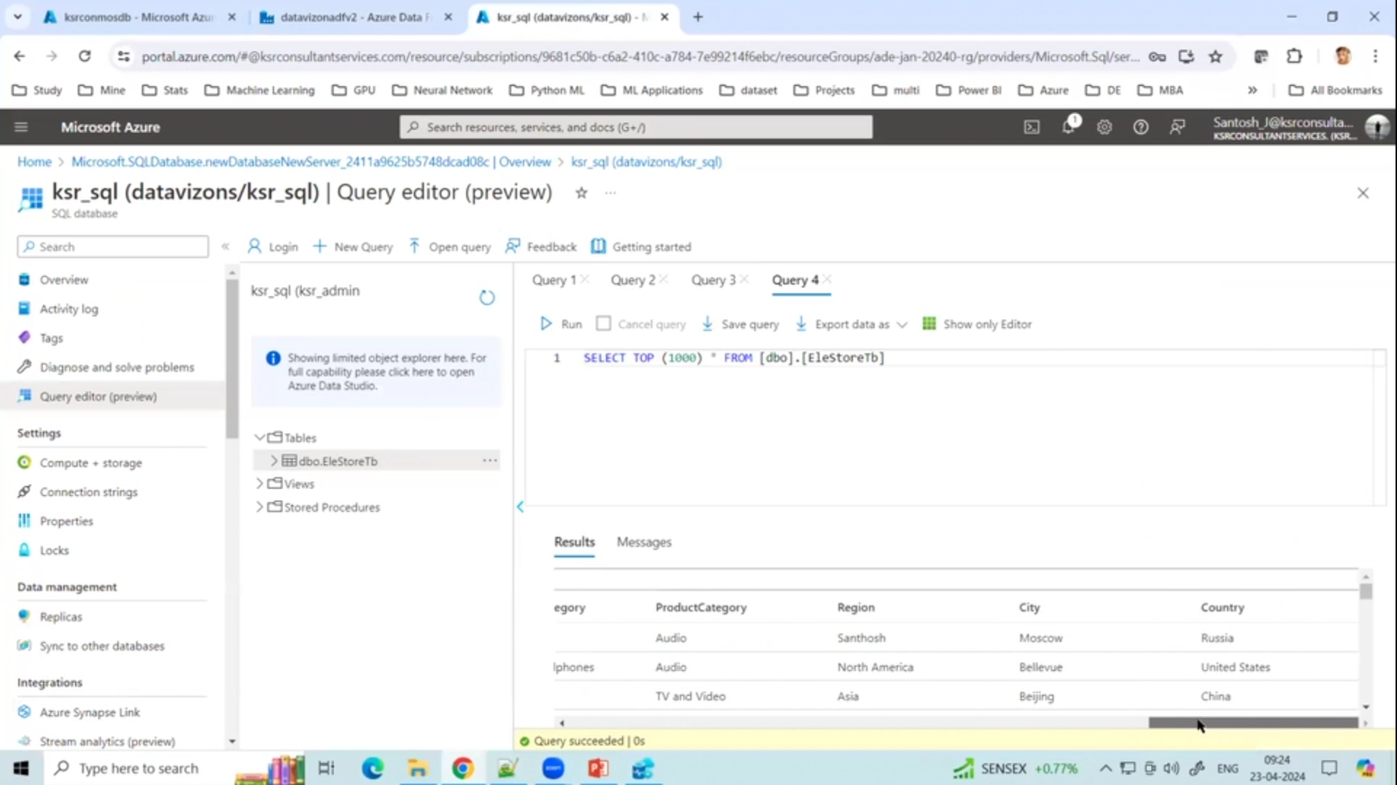
Hence the data has been brought into Azure SQL Database

